Slide 1
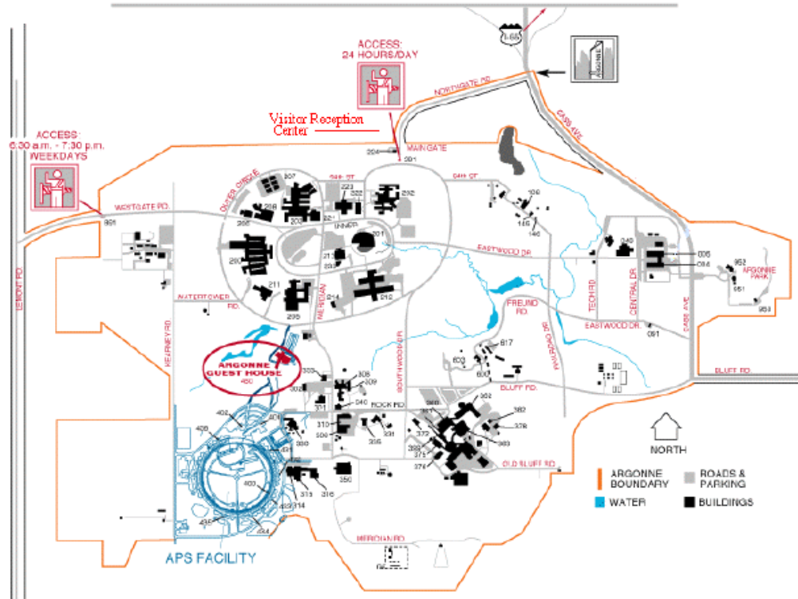
MSC
#221

Slide 2
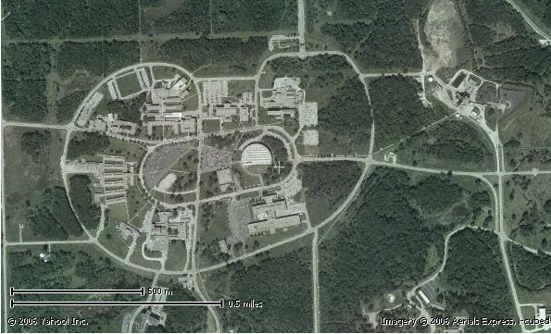
Main gate
MSC
#221
Argonne Guest House

